Slide 1
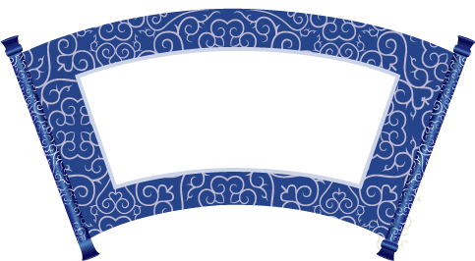
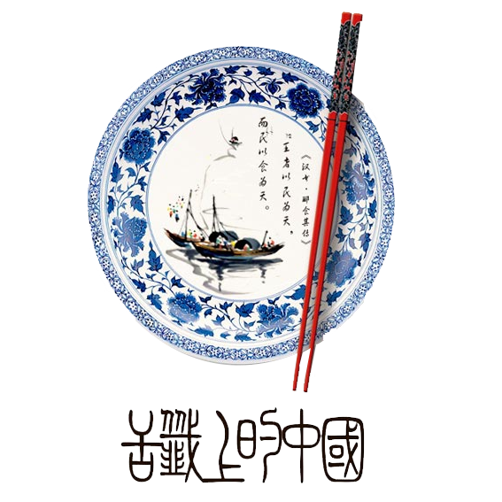




Chinese dinging manners

Slide 2
01
Reason
Contents
02
Basic Rule
03
The Setting
04
Dining at someone’s home
05
Drinking Etiquette
06
Dining with Chinese cutlery
07
Cutlery setting

Slide 3

Reason
Breaking certain rules can reflect poorly on your parents—they should have taught you better.(子不教，父之过)
Demonstrating good Chinese table manners is thought to bring health and good fortune.

Slide 4


Basic Rule
Formal seating
simply relax, observe
Your hosts will understand your nervousness. They’ll most likely do everything they can to prevent any loss of face to all parties at the table. The guest must accord to the host what he likes.(客随主便)
Host seating
lead the way, host the dining

Slide 5
The Setting
host
guest1
guest2
Table
guest3
In Chinese culture, the chair facing the entrance (or east, if possible) is known as the "command seat " the Eastern equivalent to "the head of the table.
--尚左尊东、面朝大门为尊
guest4
guest5
guest6
companion
Entrance

Slide 6

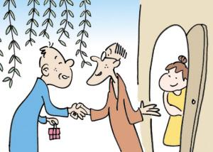
Dining at someone’s home
Sometimes, people are invited by their friends to have dinner at their home. For such an invitation, knowing some rules for dining is always necessary.
•Rise when introduced to guests
•Don’t arrive empty-handed
•Eat and praise the host
•Leave one’s shoes at the door
•Wait for the eldest or most senior person
•Hold your glass with your right hand
•Keep your chopsticks in a correct place

Slide 7
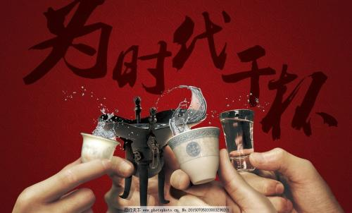
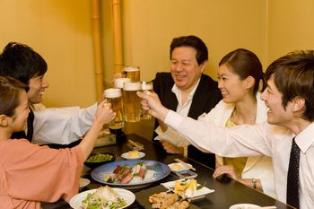

Drinking Etiquette
As with eating, drinking is done communally and follows some loose etiquette.
Hold your glass slightly lower than theirs to clink
Someone older
Someone of higher status
Wait until a toast is given
Drink with the group.
Do not drink alone
Get Out of Drinking in China
Use little white lies on such occasions to save face
Women are often excused from drinking more easily than men

Slide 8
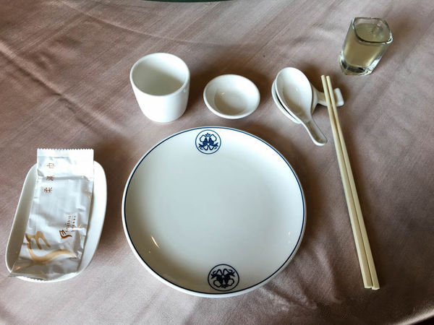

Dining with Chinese cutlery
Chopsticks:
only clip food
put down the chopsticks when talk with others
never insert the chopsticks into the food vertically
Plate (食碟):
pack food from the public plate
pack the residue of food
take a new one if full

Slide 9
Dining with Chinese cutlery
Toothpick:
don’t use it in public (use a hand to cover the mouth)
don’t hold it in the mouth
Spoon:
put it on the 食碟 when you don’t use it
Bowl:
don’t lift up the bowl
use cutlery to eat food from it
don’t put it upside down on the table

Slide 10
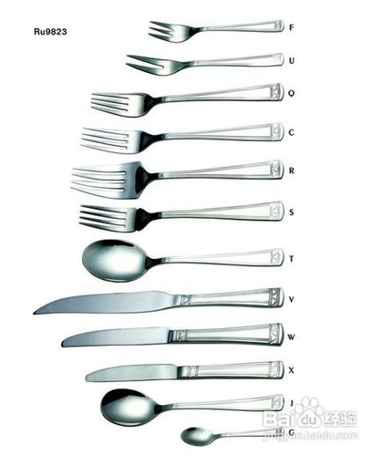
Western cutlery
Knife:
steak knife: serration is big, be used to eat steak
dinner knife: serration is small, be used to eat vegetable or fruit
butter knife: carry the butter
Fork:
fruit fork: the smallest one
salad fork: middle
dinner fork: the biggest one
Spoon:
dinner spoon: oval
soup spoon: round
dessert spoon: small
Usage:
European: the knife in the right hand, the fork in the left hand
American: cut vegetable: the knife in the right hand, the fork in the left hand
eat: put the knife on the plate and the fork in the right hand

Slide 11
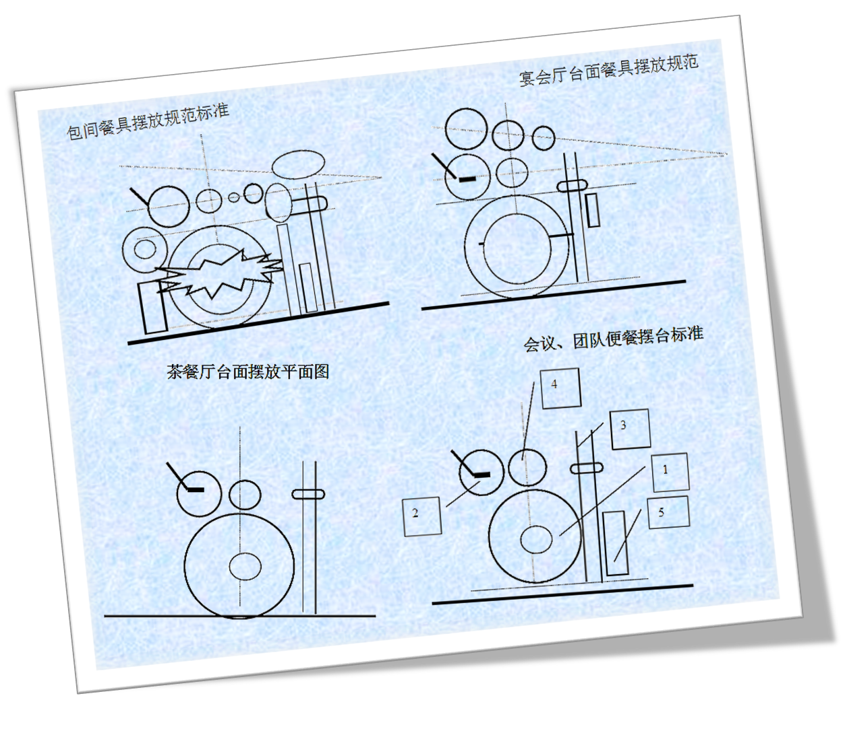
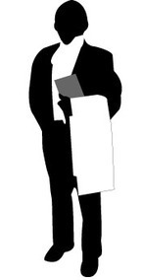
Cutlery setting
Chinese:

Slide 12
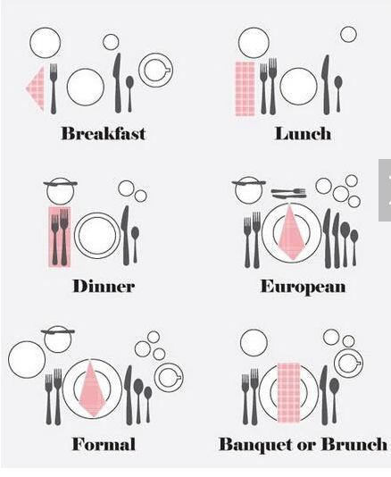
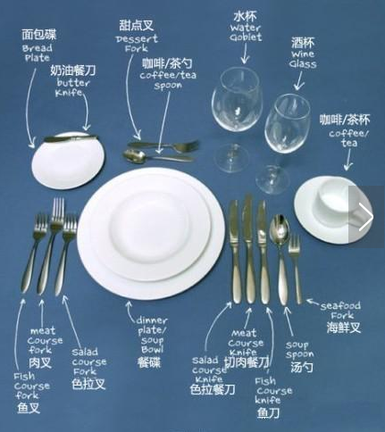
Cutlery setting
Western:

